Slide 2
Permissions and Consent We will start at 4 minutes after the hour
Microsoft identity platform
Developer Training

Slide 3
Before we get started
We are recording the sessions
Please mute your microphone
Please type your questions and comments into the chat
You can also come mute to ask a question or make a comment
Raise your hand in Teams, but this is harder for the presenter to see.

Slide 4

Applications need to access resources
Application
Resource
Microsoft Graph API
Notes:
Concept of tokens – Different types (ID and Access tokens)
Flow of application
Private conversation between AAD and the user before you talk to the web API

Slide 5
Resources need protection - Authorization
Authorization Required
Microsoft Graph API
Notes:
Concept of tokens – Different types (ID and Access tokens)
Flow of application
Private conversation between AAD and the user before you talk to the web API

Slide 6
Application requests permission
Want to access resource (scope)
Authorization Required
Microsoft Graph API
Notes:
Concept of tokens – Different types (ID and Access tokens)
Flow of application
Private conversation between AAD and the user before you talk to the web API

Slide 7


Azure AD checks for authorization
Want to access resource (scope)
Is app allowed to access the resource?
Authorization Required
Microsoft Graph API
Notes:
Concept of tokens – Different types (ID and Access tokens)
Flow of application
Private conversation between AAD and the user before you talk to the web API

Slide 8
Permission is Granted or Denied - Consent
Want to access resource (scope)
Is app allowed to access the resource?
A
Authorization Required
Microsoft Graph API
Notes:
Concept of tokens – Different types (ID and Access tokens)
Flow of application
Private conversation between AAD and the user before you talk to the web API

Slide 9
Access token sent to app
Want to access resource (scope)
A
Authorization Required
Microsoft Graph API
Notes:
Concept of tokens – Different types (ID and Access tokens)
Flow of application
Private conversation between AAD and the user before you talk to the web API

Slide 10
App has access token - permission - authorization
Authorization Required
A
Microsoft Graph API
Notes:
Concept of tokens – Different types (ID and Access tokens)
Flow of application
Private conversation between AAD and the user before you talk to the web API

Slide 11
Still have a problem?
A
Authorization Required
Microsoft Graph API
Notes:
Concept of tokens – Different types (ID and Access tokens)
Flow of application
Private conversation between AAD and the user before you talk to the web API

Slide 12




https://graph.microsoft.com
graph.microsoft.com
graph.microsoft.com
USERS
GROUPS
FILES
MAIL
CALENDAR
TASKS
Insights and relationships from Graph

Slide 13
Some APIs have a rich surface area
Authorization Required
USERS
GROUPS
FILES
MAIL
CALENDAR
TASKS
…
Notes:
Concept of tokens – Different types (ID and Access tokens)
Flow of application
Private conversation between AAD and the user before you talk to the web API

Slide 14
Least Privilege – Asking for just enough
Read users
USERS
Update users
Read Groups
Want to Read Calendar (scope)
GROUPS
Read Cal
Update Groups
Read Files
FILES
Update Files
Read Mail
MAIL
Update Mail
Read Calendar
CALENDAR
Update Calendar
Read Tasks
TASKS
Update Tasks
…
Notes:
Concept of tokens – Different types (ID and Access tokens)
Flow of application
Private conversation between AAD and the user before you talk to the web API

Slide 15
Least Privilege – Granting just enough
Read users
USERS
Update users
Read Groups
Want to Read Calendar (scope)
GROUPS
Read Cal
Update Groups
Read Files
FILES
Update Files
Read Mail
MAIL
Update Mail
Read Calendar
CALENDAR
Update Calendar
Read Tasks
TASKS
Update Tasks
…
Notes:
Concept of tokens – Different types (ID and Access tokens)
Flow of application
Private conversation between AAD and the user before you talk to the web API

Slide 16
App has Least Privilege – just enough
Read users
USERS
Update users
Read Groups
GROUPS
Update Groups
Read Files
FILES
Update Files
Read Mail
MAIL
Update Mail
Read Calendar
CALENDAR
Update Calendar
Read Tasks
Read Cal
TASKS
Update Tasks
…
Notes:
Concept of tokens – Different types (ID and Access tokens)
Flow of application
Private conversation between AAD and the user before you talk to the web API

Slide 17
App has Least Privilege – just enough
Read users
USERS
Update users
Read Groups
GROUPS
Update Groups
Read Files
FILES
Update Files
Read Mail
Read Cal
MAIL
Update Mail
Read Calendar
CALENDAR
Update Calendar
Read Tasks
TASKS
Update Tasks
…
Notes:
Concept of tokens – Different types (ID and Access tokens)
Flow of application
Private conversation between AAD and the user before you talk to the web API

Slide 18
Least Privilege – Asking for just enough
Read users
USERS
Update users
Read Groups
GROUPS
Update Groups
Read Files
FILES
Update Files
Read Mail
Read Cal
MAIL
Update Mail
Read Calendar
CALENDAR
Update Calendar
Read Tasks
TASKS
Update Tasks
…
Notes:
Concept of tokens – Different types (ID and Access tokens)
Flow of application
Private conversation between AAD and the user before you talk to the web API

Slide 19
Types of permissions
Delegated permissions
Permissions which operate in the context of the signed-in user.
Always used if a user is present
Application permissions
Permissions that have effect on behalf of the client app itself, with no user present.
Used only when no user is present

Slide 20
Delegated Permissions

Slide 21

Application requests permission
Want to access resource (scope) on behalf of the user
Authorization Required
When a user is present the app is compelled to use delegated permissions
Microsoft Graph API
Notes:
Concept of tokens – Different types (ID and Access tokens)
Flow of application
Private conversation between AAD and the user before you talk to the web API

Slide 22
Azure AD needs to know the user
Want to access resource (scope) on behalf of the user
Authorization Required
Private conversation with the user
Microsoft Graph API
Notes:
Concept of tokens – Different types (ID and Access tokens)
Flow of application
Private conversation between AAD and the user before you talk to the web API

Slide 23
Azure AD checks for authorization
Want to access resource (scope)
Is app allowed to access the resource?
Admin consent granted?
User has granted consent to app?
Authorization Required
Microsoft Graph API
Notes:
Concept of tokens – Different types (ID and Access tokens)
Flow of application
Private conversation between AAD and the user before you talk to the web API

Slide 24
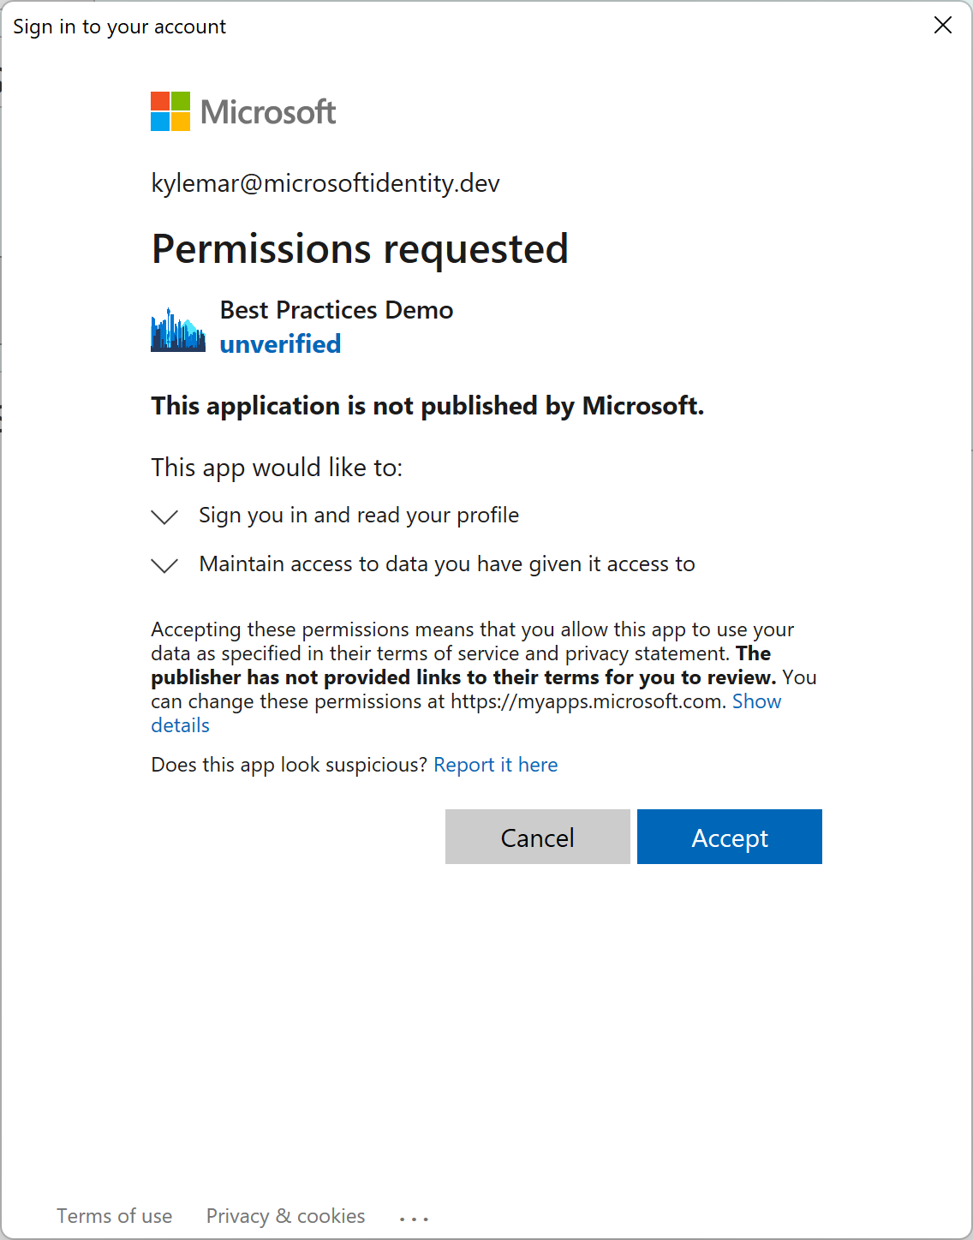
Azure AD checks for authorization
Want to access resource (scope)
Is app allowed to access the resource?
Authorization Required
Private conversation with the user
Microsoft Graph API
Notes:
Concept of tokens – Different types (ID and Access tokens)
Flow of application
Private conversation between AAD and the user before you talk to the web API

Slide 25
Azure AD checks for authorization
Want to access resource (scope)
Is app allowed to access the resource?
Authorization Required
Private conversation with the user
Microsoft Graph API
Notes:
Concept of tokens – Different types (ID and Access tokens)
Flow of application
Private conversation between AAD and the user before you talk to the web API

Slide 26
Azure AD checks for authorization
Want to access resource (scope)
Is app allowed to access the resource?
Authorization Required
Private conversation with the user
Microsoft Graph API
Notes:
Concept of tokens – Different types (ID and Access tokens)
Flow of application
Private conversation between AAD and the user before you talk to the web API

Slide 27
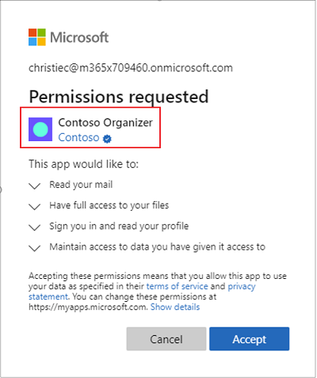
Publisher verification
Helps to understand the authenticity of application developers
Increased transparency and risk reduction for customers
Improved branding
Smoother enterprise adoption

Slide 28
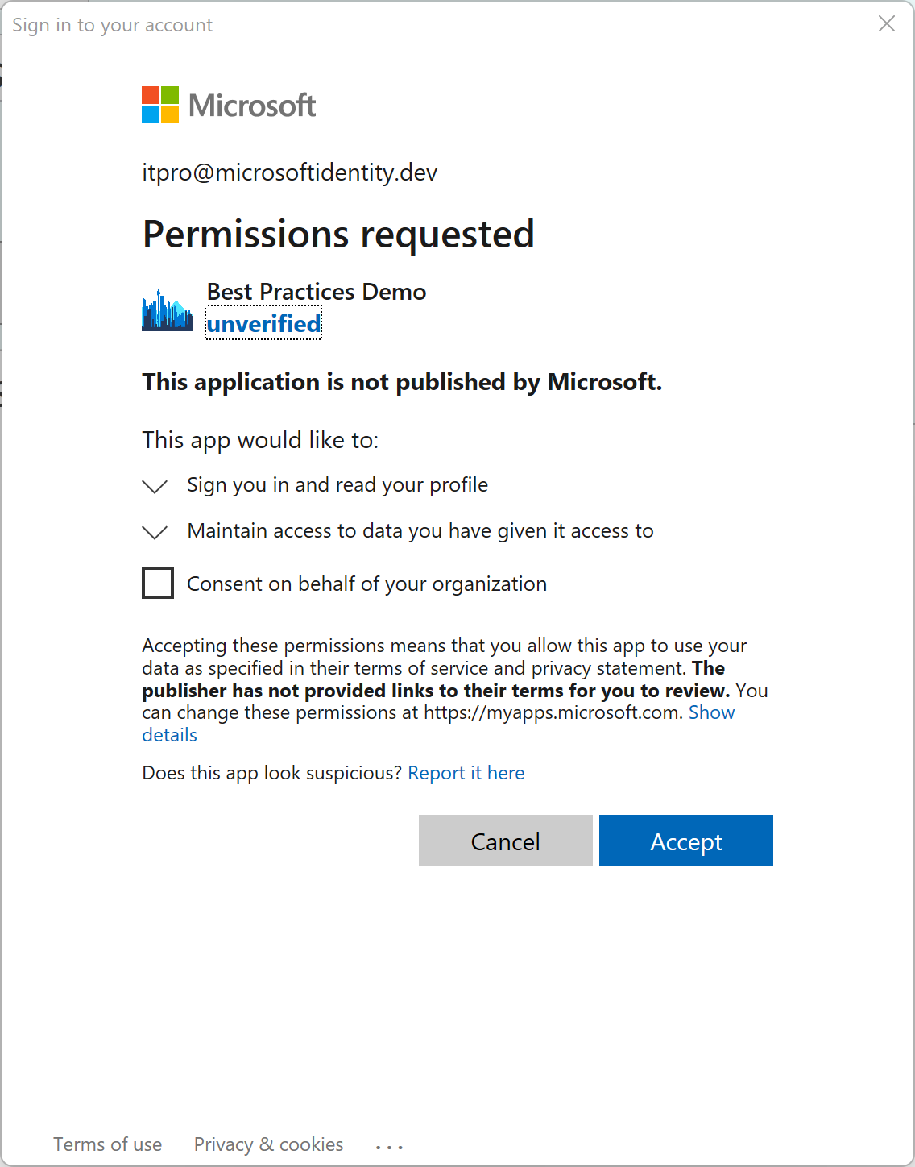
Azure AD checks for authorization
Want to access resource (scope)
Is app allowed to access the resource?
Authorization Required
Private conversation with the user
Microsoft Graph API
Notes:
Concept of tokens – Different types (ID and Access tokens)
Flow of application
Private conversation between AAD and the user before you talk to the web API

Slide 29
Permission is Granted or Denied - Consent
Want to access resource (scope)
A
Authorization Required
Microsoft Graph API
Notes:
Concept of tokens – Different types (ID and Access tokens)
Flow of application
Private conversation between AAD and the user before you talk to the web API

Slide 30
Permission is Granted or Denied - Consent
Want to access resource (scope)
A
Authorization Required
Microsoft Graph API
Notes:
Concept of tokens – Different types (ID and Access tokens)
Flow of application
Private conversation between AAD and the user before you talk to the web API

Slide 31
App has access token - authorization
Want to access resource (scope)
Authorization Required
A
Microsoft Graph API
Notes:
Concept of tokens – Different types (ID and Access tokens)
Flow of application
Private conversation between AAD and the user before you talk to the web API

Slide 32
App can access resource
Resource MUST check authorization of the app (token validation) and the user (up to the resource)
A
Authorization Required
Microsoft Graph API
Notes:
Concept of tokens – Different types (ID and Access tokens)
Flow of application
Private conversation between AAD and the user before you talk to the web API

Slide 33
Apps are granted consent for the apps range of operation
Users have permissions for operations managed by their organization
Effective Permissions The intersection of app permissions and user capabilities

Slide 34
Apps are granted consent for the apps range of operation
Users have permissions for operations managed by their organization
Effective Permissions The intersection of app permissions and user capabilities

Slide 35
Resources MUST authorize the App and the User
Apps are granted consent for the apps range of operation
Effective Permissions The intersection of app permissions and user capabilities
Users have permissions for operations managed by their organization

Slide 36
Demo Declaring delegated permissions
Notes:
App registration
Open demo app
Go to API Permissions
Show permissions declared
Add a permission
Select Microsoft Graph
Select Delegated Permissions
Type user
Show permissions

Slide 37
When can an Application request consent?
While we strongly recommend applications declare all permissions the app requires, declaring permissions is NOT REQUIRED
Apps request permissions in the code of the app
Dynamically
Incrementally
Statically

Slide 38
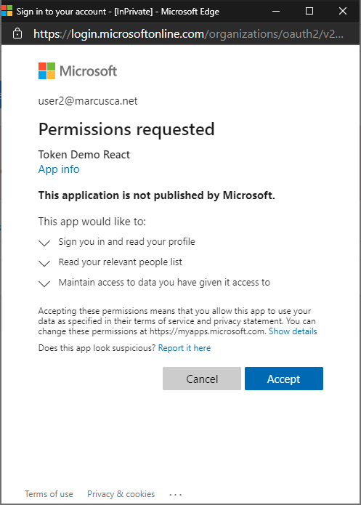
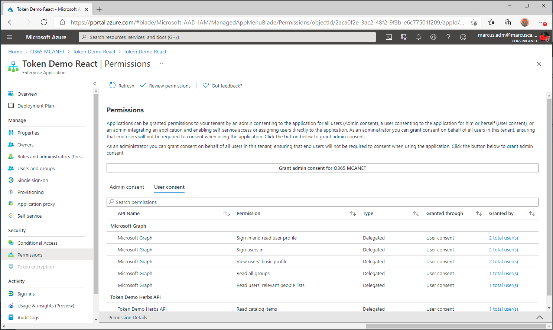
Dynamic consent: Permissions requested inside the code
App requests: User.Read People.Read
Generally, permissions that every user will need
Granted permissions visible under “Enterprise Applications”
Notes:
There are two other reason

Slide 39
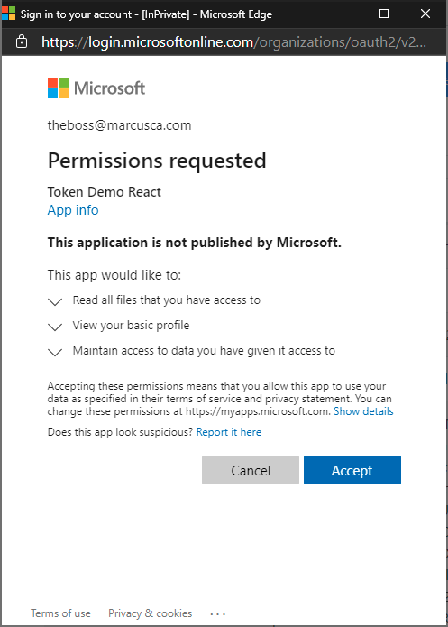
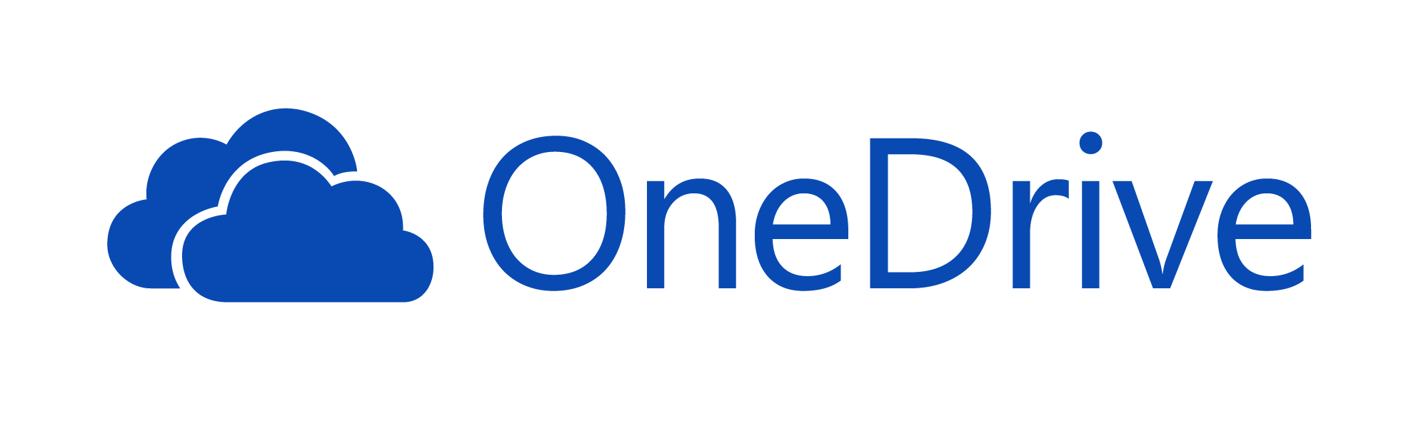
Incremental consent: Permissions requested as the user needs them
Certain permissions may scare off users, especially the first time they use the app
App requests: Files.Read.All

Slide 40
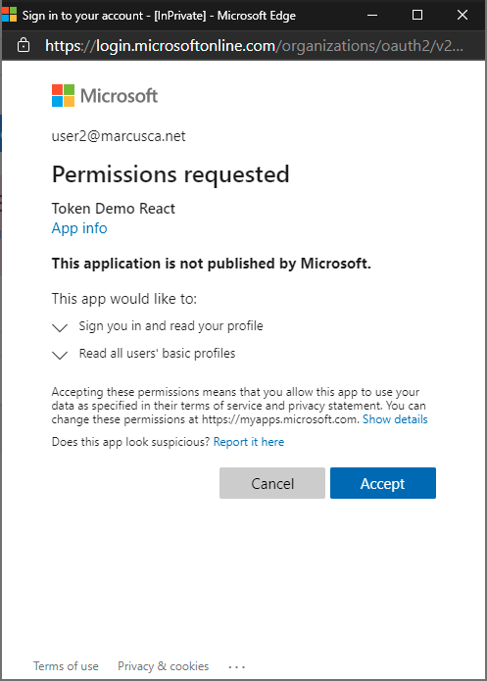
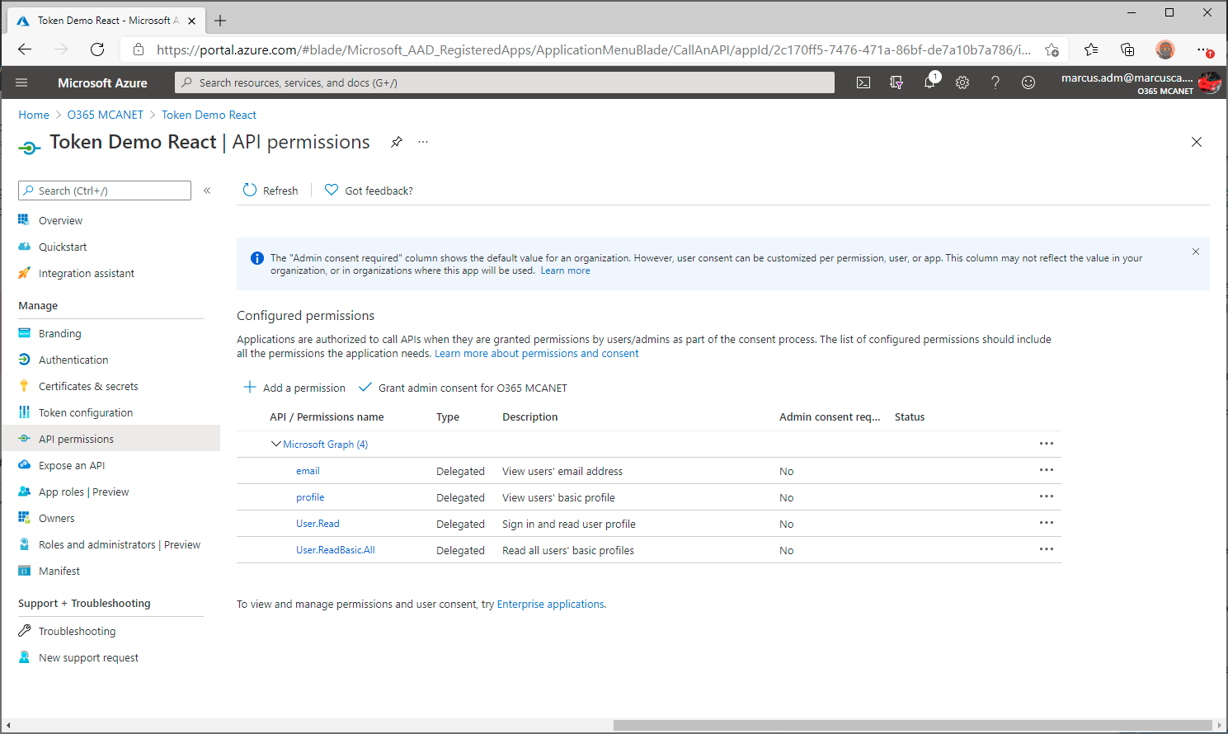
Static user consent: Permissions declared upfront by admin or app owner
Will represent all permissions configured in the App registration
App requests: .default
Note: /.default triggers a consent prompt only if the user has not granted permissions for the app to the resource
Notes:
There are two other reason

Slide 41
Delegated Permissions
Authorize an app to access a resource on behalf of the signed in user
Must be granted by the current user or an admin
App’s effective permission is the intersection of delegated permission and user capabilities
Apps can request access dynamically, incrementally, or statically

Slide 42
How does Microsoft use Permissions?
Let’s look at an example from Microsoft Graph

Slide 43
Microsoft Graph permissions names
Resource.Operation.Constraint
Constraint | What it does
All | Grants permission for the app to perform the operations on all of the resources of the specified type in a directory.
Shared | Grants permission for the app to perform the operations on resources that other users have shared with the signed-in user. This constraint is mainly used with Outlook resources like mail, calendars, and contacts.
AppFolder | Grants permission for the app to read and write files in a dedicated folder in OneDrive. This constraint is only exposed on Files permissions and is only valid for Microsoft accounts.
none | If no constraint is specified the app is limited to performing the operations on the resources owned by the signed-in user.

Slide 44
Microsoft Graph User Permissions (Examples)
Permission | Display String | Description
User.Read | Sign-in and read user profile | Allows users to sign-in to the app and allows the app to read the profile of signed-in users. It also allows the app to read basic company information of signed-in users.
User.ReadWrite | Read and write access to user profile | Allows the app to read the signed-in user's full profile. It also allows the app to update the signed-in user's profile information on their behalf.
User.ReadBasic.All | Read all users' basic profiles | Allows the app to read a basic set of profile properties of other users in your organization on behalf of the signed-in user. This includes display name, first and last name, email address, open extensions and photo. Also allows the app to read the full profile of the signed-in user.
https://docs.microsoft.com/en-us/graph/permissions-reference

Slide 45
More User Permissions…
Permission | Display String | Description
User.Read | Sign-in and read user profile | Allows users to sign-in to the app and allows the app to read the profile of signed-in users. It also allows the app to read basic company information of signed-in users.
User.ReadWrite | Read and write access to user profile | Allows the app to read the signed-in user's full profile. It also allows the app to update the signed-in user's profile information on their behalf.
User.ReadBasic.All | Read all users' basic profiles | Allows the app to read a basic set of profile properties of other users in your organization on behalf of the signed-in user. This includes display name, first and last name, email address, open extensions and photo. Also allows the app to read the full profile of the signed-in user.
User.Read.All | Read all users' full profiles | Allows the app to read the full set of profile properties, reports, and managers of other users in your organization, on behalf of the signed-in user.
User.ReadWrite.All | Read and write all users' full profiles | Allows the app to read and write the full set of profile properties, reports, and managers of other users in your organization, on behalf of the signed-in user. Also allows the app to create and delete users as well as reset user passwords on behalf of the signed-in user.

Slide 46
Admin Consent Required?
Permission | Display String | Description | Admin?
User.Read | Sign-in and read user profile | Allows users to sign-in to the app and allows the app to read the profile of signed-in users. It also allows the app to read basic company information of signed-in users. | No
User.ReadWrite | Read and write access to user profile | Allows the app to read the signed-in user's full profile. It also allows the app to update the signed-in user's profile information on their behalf. | No
User.ReadBasic.All | Read all users' basic profiles | Allows the app to read a basic set of profile properties of other users in your organization on behalf of the signed-in user. This includes display name, first and last name, email address, open extensions and photo. Also allows the app to read the full profile of the signed-in user. | No
User.Read.All | Read all users' full profiles | Allows the app to read the full set of profile properties, reports, and managers of other users in your organization, on behalf of the signed-in user. | Yes
User.ReadWrite.All | Read and write all users' full profiles | Allows the app to read and write the full set of profile properties, reports, and managers of other users in your organization, on behalf of the signed-in user. Also allows the app to create and delete users as well as reset user passwords on behalf of the signed-in user. | Yes

Slide 47
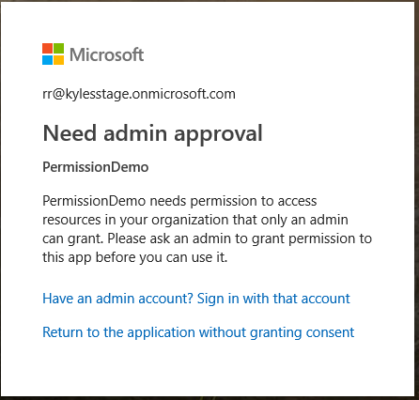
Users can not grant consent for a permission that requires Admin consent

Slide 48
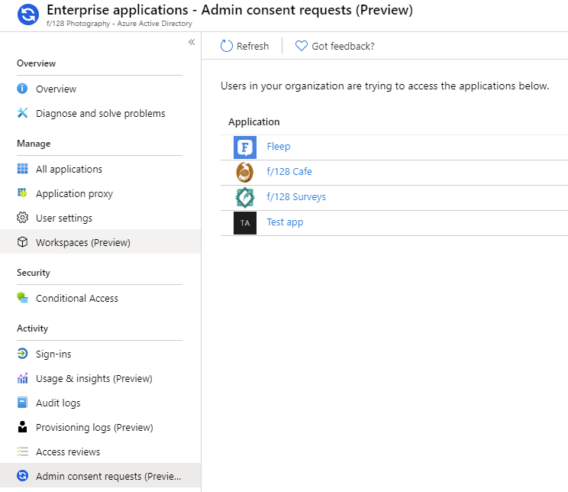
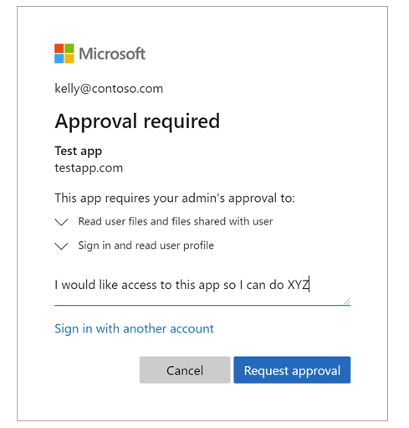

Slide 49
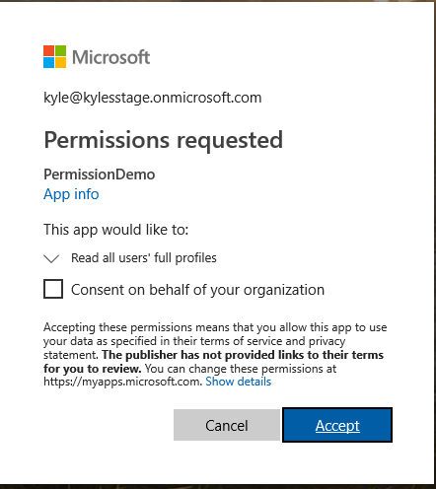
Users can not grant consent for a permission that requires Admin consent
Admins can grant this consent
When running the app

Slide 50
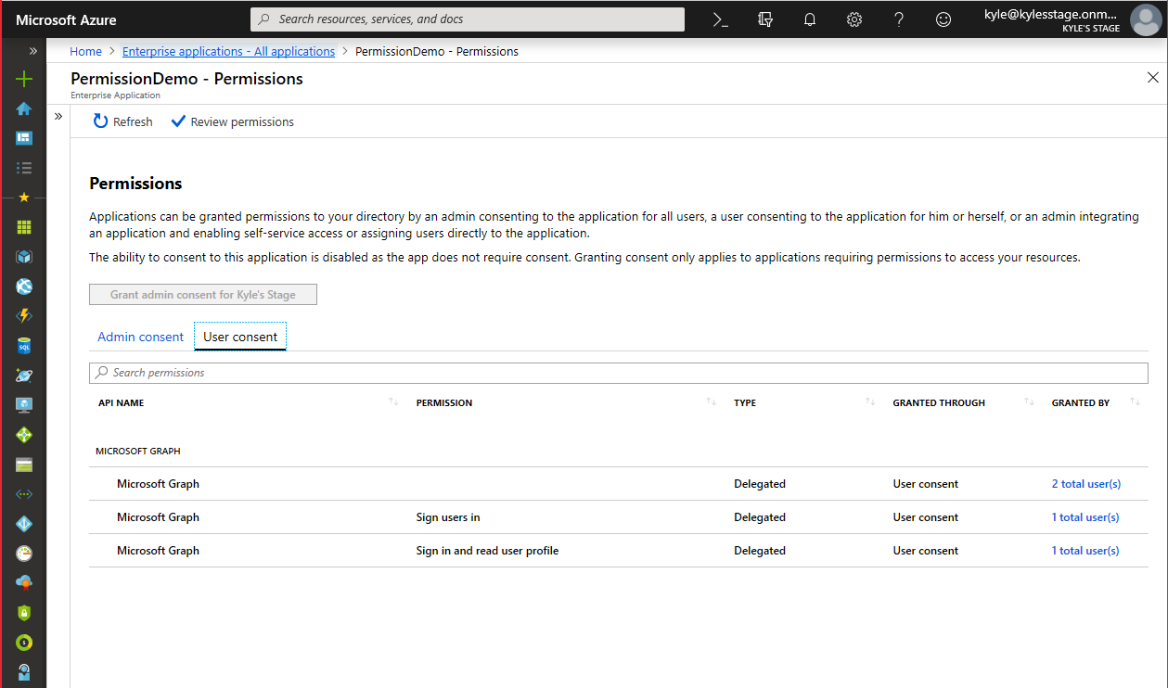
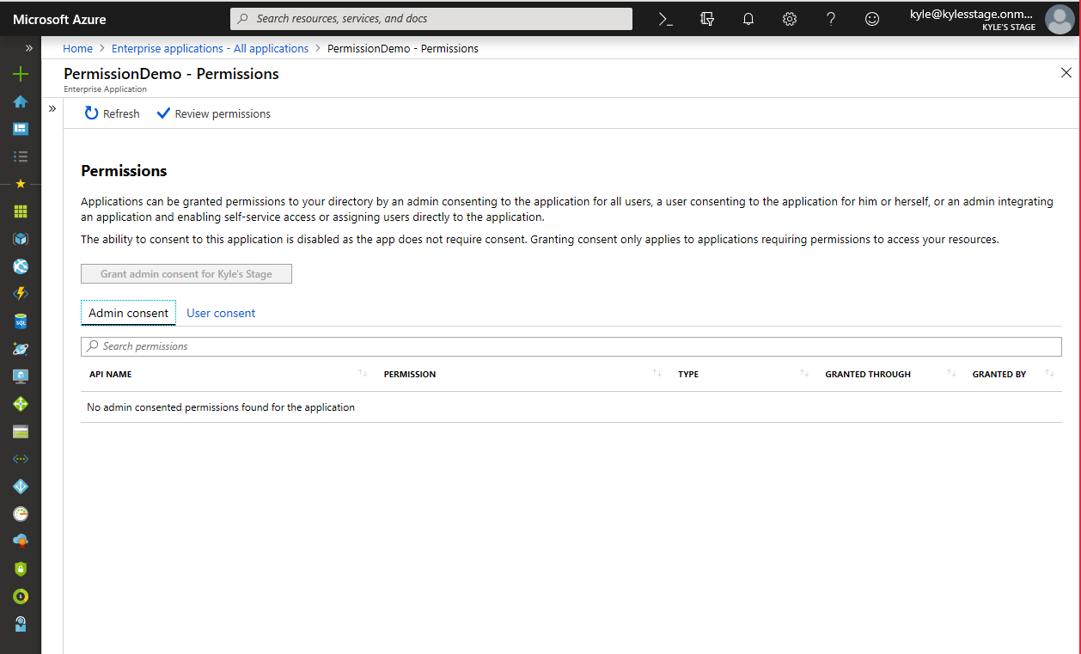
Great choice for LOB apps
Developers should declare all permissions ahead of time
Admins can also consent for all users in the organization
Applies to both consent User and Admin permissions
When running the app
In the Azure Portal

Slide 51
Application Permissions

Slide 52

Application requests permission
Want to access resource Must use .default scope
Must provide Client Credential
Authorization Required
Microsoft Graph API
Notes:
Concept of tokens – Different types (ID and Access tokens)
Flow of application
Private conversation between AAD and the user before you talk to the web API

Slide 53
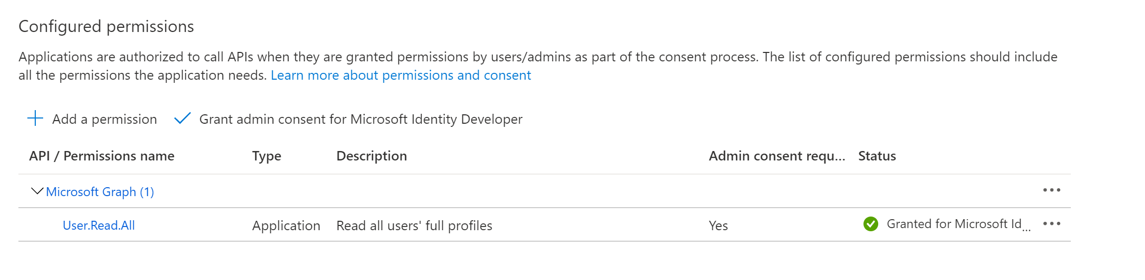
Azure AD checks for authorization
Want to access resource Must use .default scope
Is app allowed to access the resource?
Must provide Client Credential
Must be consented by Admin
Must be done before service runs
Authorization Required
Microsoft Graph API
Notes:
Concept of tokens – Different types (ID and Access tokens)
Flow of application
Private conversation between AAD and the user before you talk to the web API

Slide 54
Permission is Granted or Denied - Consent
Want to access resource Must use .default scope
Is app allowed to access the resource?
A
Must provide Client Credential
Authorization Required
Microsoft Graph API
Notes:
Concept of tokens – Different types (ID and Access tokens)
Flow of application
Private conversation between AAD and the user before you talk to the web API

Slide 55
Access token sent to app
Want to access resource Must use .default scope
A
Must provide Client Credential
Authorization Required
Microsoft Graph API
Notes:
Concept of tokens – Different types (ID and Access tokens)
Flow of application
Private conversation between AAD and the user before you talk to the web API

Slide 56
App has access token - permission - authorization
Authorization Required
A
Microsoft Graph API
Notes:
Concept of tokens – Different types (ID and Access tokens)
Flow of application
Private conversation between AAD and the user before you talk to the web API

Slide 57
App has access token - permission - authorization
A
Authorization Required
Microsoft Graph API
Notes:
Concept of tokens – Different types (ID and Access tokens)
Flow of application
Private conversation between AAD and the user before you talk to the web API

Slide 58
Demo Declaring application permissions
Notes:
App registration
Open demo service app
Go to API Permissions
Show permissions declared
Add a permission
Select Microsoft Graph
Select Application Permissions
Type user
Show permissions

Slide 59
Application Permissions
App proves it is the app requesting permission with a client credential
Secret – OK (but needs help)
Certificates – Good
Workload identity federation - Good
Managed Identity for Azure Resources – Best if building on Azure
Ask the Azure Resource for the access token
Admin consent – Always
By default, app can access all instances of the resource
User.ReadWrite.All – update all users profiles
Calendars.Read – read all calendars in the tenant
Permissions granted the app are always the permissions used

Slide 60
Limit App Permissions
Resource Specific Consent
Microsoft Teams - Enable resource-specific consent in Teams - Teams | Microsoft Docs
Exchange Application Policies
Mailboxes - Limiting application permissions to specific Exchange Online mailboxes - Microsoft Graph | Microsoft Docs
Sites.Selected
SharePoint - Controlling app access on a specific SharePoint site collections is now available in Microsoft Graph - Microsoft 365 Developer Blog

Slide 61
Application Permissions
Authorize an app to access a resource
Must be granted by an admin before the app runs
By default, access is to all instances of the resource
Teams, Exchange, and SharePoint have methods to limit access
Apps must use .default to request access

Slide 62
Is this going to be on the test?

Slide 63
Example: Cactus API
A very simple API
GET /items – list all items
GET /items/{id} – get one item
Exposes two delegated permissions
Catalog.View.All: List all items
Catalog.View.Published: List only published items
Has two types of users
Admin: Can view all items
User: Can view only published items
Catalog contents
[
{
"id": 1,
"name": "Cephalocereus senilis",
"status": "published"
},
{
"id": 2,
"name": "Neobuxbaumia polylopha",
"status": "unpublished"
},
{
"id": 3,
"name": "Myrtillocactus geometrizans",
"status": "published"
}
]

Slide 64
Example: Cactus Catalog A client of Cactus API
A single-page JavaScript app requesting the Catalog.View.Published permission, used to list catalog items
Q: Is this a delegated permission (scope) or application permission (app role)?
A: It must be delegated, because:
There are users in front of the app
A single page app can’t keep a secret, so can’t be a confidential client.
Cactus Catalog
Catalog API

Slide 65
Example: Cactus Catalog A client of Cactus API
ID | Name | Status
1 | Cephalocereus senilis | published
2 | Neobuxbaumia polylopha | unpublished
3 | Myrtillocactus geometrizans | published
App has consent for Catalog.View.Published: List only published items
Admins can view all items
GET /items
[
{
"id": 1,
"name": "Cephalocereus senilis",
"status": "published"
},
{
"id": 3,
"name": "Myrtillocactus geometrizans",
"status": "published"
}
]
Alice, who is an Admin, signs in to Cactus Catalog and calls GET /items
Q: What’s the result?
A: Only published items are listed. Although Alice is considered an Admin by the API and is allowed to view all items, the client app has limited delegated permissions.

Slide 66
Example: Cactus Catalog A client of Cactus API
ID | Name | Status
1 | Cephalocereus senilis | published
2 | Neobuxbaumia polylopha | unpublished
3 | Myrtillocactus geometrizans | published
App has consent for Catalog.View.Published: List only published items
Users can view only published items
GET /items/1
{
"id": 1,
"name": "Cephalocereus senilis",
"status": "published"
}
Bob, who is a User, signs in to Cactus Catalog and calls GET /items/1
Q: What’s the result?
A: The requested item is returned. Because it is a published item, both Bob and the client app (on Bob’s behalf) have permission.

Slide 67
Example: Cactus Catalog A client of Cactus API
ID | Name | Status
1 | Cephalocereus senilis | published
2 | Neobuxbaumia polylopha | unpublished
3 | Myrtillocactus geometrizans | published
App has consent for Catalog.View.Published: List only published items
Admins can view all items
GET /items/2
403 Forbidden
401 Unauthorized
Alice, who is an Admin, signs in to Cactus Catalog and calls GET /items/2
Q: What’s the result?
A: An authorization error is returned. Although Alice is considered an Admin by the API and is allowed to view all items, the client app has limited delegated permissions and is not allowed to read unpublished items.

Slide 68
Example: Cactus Catalog A client of Cactus API
ID | Name | Status
1 | Cephalocereus senilis | published
2 | Neobuxbaumia polylopha | unpublished
3 | Myrtillocactus geometrizans | published
App has consent for Catalog.View.All: List all items
Users can view only published items
GET /items/2
401 Unauthorized
Now suppose the Cactus Catalog app is granted the delegated permission Catalog.View.All
Bob, a User, signs in to Cactus Catalog and calls GET /items/2
Q: What should be the result?
A: An authorization error. Even though the app has delegated permissions to read all items, these permissions are restricted by what the user is actually allowed to do, and Bob isn’t allowed to read unpublished items.

Slide 69

Permission and Consent Framework
For Labs and Exercises please refer to the below link -
Permissions and Consent Framework - Learn | Microsoft Docs

Slide 71
Microsoft Graph permissions names
Resource.Operation.Constraint
Constraint | What it does
All | Grants permission for the app to perform the operations on all of the resources of the specified type in a directory.
Shared | Grants permission for the app to perform the operations on resources that other users have shared with the signed-in user. This constraint is mainly used with Outlook resources like mail, calendars, and contacts.
AppFolder | Grants permission for the app to read and write files in a dedicated folder in OneDrive. This constraint is only exposed on Files permissions and is only valid for Microsoft accounts.
none | If no constraint is specified the app is limited to performing the operations on the resources owned by the signed-in user.

